Slide 1
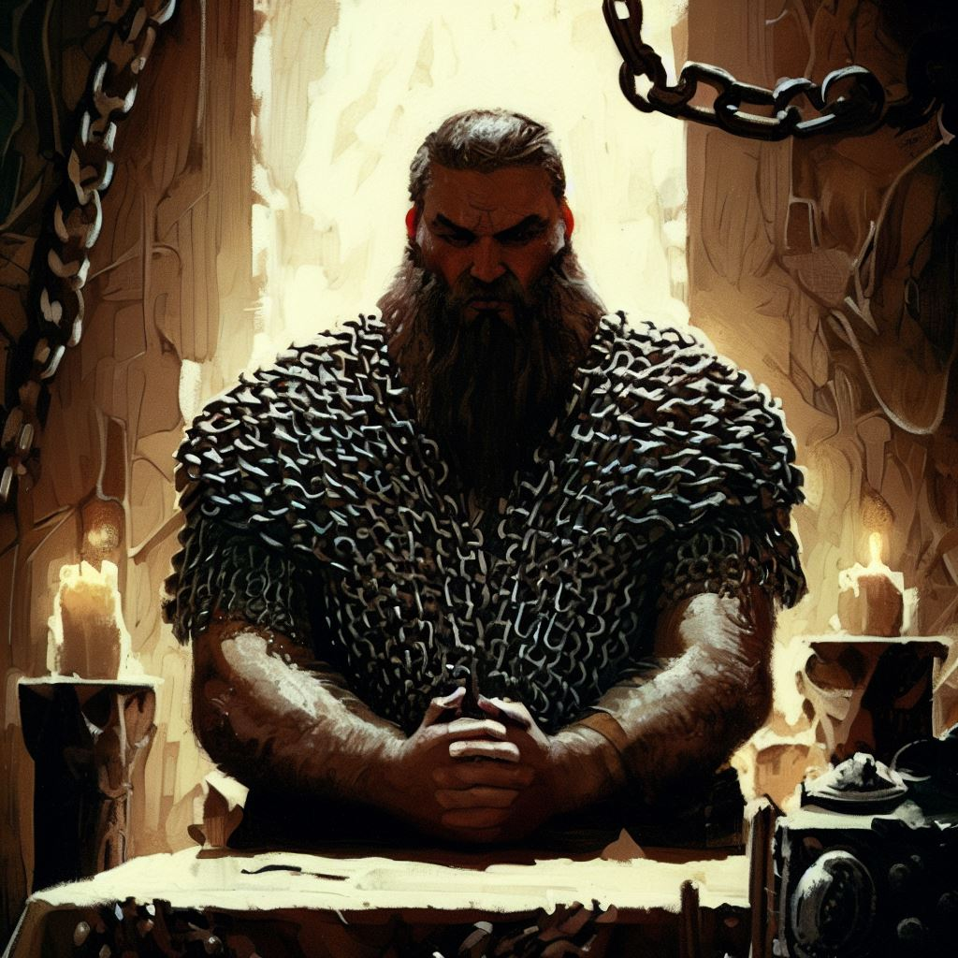
Borloin Gorsk
Background: In the shadowed corridors of Nevarellon, where the storm-touched faith of the Tempest Scions holds sway, there emerges Borloin, an orphaned soul raised in the austere embrace of the Tempest Faith.
From his earliest days, Borloin has navigated the turbulent currents of a life shaped by the harsh disciplines of a faith obsessed with physical and mental endurance.
Borloin's infancy unfolded beneath the watchful eyes of the faithful, who moulded his spirit through a relentless regimen of rituals. These rites, intended to prepare the soul for the enigmatic 'Cleansing Storm,' whispered of rebirth, a divine act that would reshape the world in the image of the Storm King Talos.
Borloin, resilient in both body and spirit, emerged from this crucible with a fervent commitment to his faith. As the years wove the fabric of his devotion, his unwavering dedication was met with divine favor. Blessed by the Tempest God to be an anointed cleric of the impending Storm, Borloin now walks the path of a chosen vessel, entrusted with the sacred duty of enacting the will of the Tempest.
Yet, with this divine calling comes a peculiar burden. Borloin, since his anointing, has been haunted by dreams that dance on the fringes of confusion and chaos. He perceives these nocturnal visions as messages from the Tempest God, yet their meaning eludes him, leaving him to grapple with the enigmatic whispers that echo in the recesses of his mind.
In the bustling streets of Nevarellon, Borloin carries the mantle of an anointed cleric with solemn grace. His every step resonates with the weight of divine purpose, and his presence commands a certain reverence among the Tempest Scions. Yet, behind the facade of unwavering faith, Borloin grapples with the cryptic dreams that mark the boundaries between mortal and divine comprehension. His journey, an odyssey through tempest-touched rites and mystic dreams, unfolds against the backdrop of a city where the storm's whispers are both a guiding light and an enigmatic labyrinth.
In Borloin, the tempest finds a faithful conduit, a mortal vessel bound by a destiny entwined with the echoes of a coming storm that will reshape both the heavens and the earth.
Race: Dwarf
Class: Cleric
Age: 63
Height: 5ft
Weight:162lbs
Eyes: Grey
Skin: Light tan
Hair: Auburn
Personality Traits: I see Omens in every event & action. The Gods try to speak to us.
Ideals: I seek to prove myself worthy of my God’s favor by matching my actions to their teachings.
Bonds: I would die to recover an ancient relic of my faith.
Flaws: I put too much trust in those who would wield power within my temples Hierarchy.
Motivation: Borloin does not want for wealth. He will donate whatever he does not need beyond a commoners lifestyle to the Temple of the Tempest Sky.
Borloin strives to prove himself to the Tempest God King Talos and to demonstrate the will/might/power/traditions of faith in Talos.

Slide 2
STR | +1
 | 13
DEX | +0
 | 10
CON | +3
 | 16
INT | +1
 | 12
WIS | +3
 | 16
CHA | -1
 | 8
Proficiency Bonus | +2
AC
16
Speed
25
Skills;
Acrobatics [dex] | +0
Animal handling [wis] | +3
Arcana [int] | +1
Athletics [str] | +1
Deception [cha] | -1
History [int] | +3
Insight [wis] | +5
Intimidate [cha] | -1
Investigation [int] | +1
Medicine [wis] | +3
Nature [int] | +1
Perception [wis] | +3
Performance [cha] | -1
Persuasion [cha] | +1
Religion [int] | +3
Sleight of hand [dex] | +0
Stealth [dex] | +0
Survival [wis] | +3
Initiative
+0
HP MAX | 21
Current HP
Temp HP
Hit dice
2 | D8
Death saves;
Successes
Failures
Saving throws;
Str | +1
Dex | +0
Con | +3
Int | +1
Wis | +5
Cha | +2
Passive wisdom [Perception] | 13

